Slide 1
6-1. K-nearest neighbors (KNN)
Youngsoo Kim <pineland@hanmail.net>
Code : https://github.com/pineland/AIDA/

Slide 2
Contents
KNN concepts
KNN algorithm
KNN variations
Applications of KNN

Slide 3
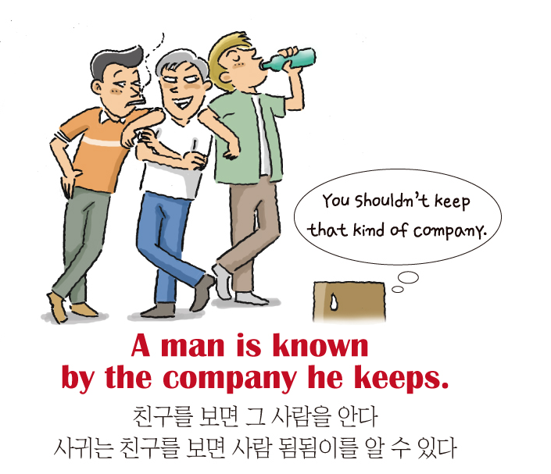
類類相從

Slide 4
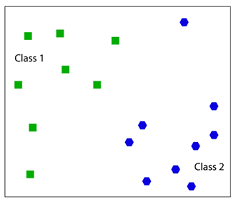
What is KNN ?
A lazy learning algorithm that classifies data sets based on their similarity with neighbors.
“K” stands for number of data set items that are considered for the classification
KNN’s different names
Instance-based learning
Example-based reasoning
Memory-based reasoning
Lazy Learning

Slide 5
Lazy Learners vs. Eager Learners
Lazy learning (e.g., instance-based learning)
Simply stores training data and waits until it is given a new data.
Since Lazy learners store the training instances, they are also referred to as instance based learners
Eager learning
Given a set of training instances, constructs a classification model before receiving new data to classify.

Slide 6
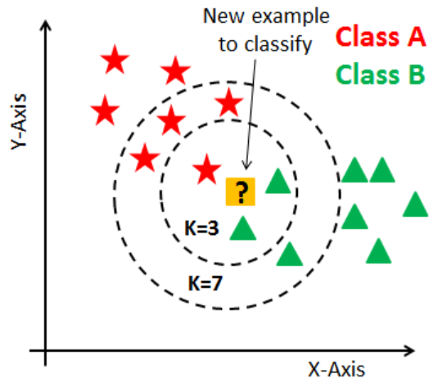
KNN algorithm
Classification is done by comparing feature vectors of different K nearest points.
Select the K-nearest examples to the new input in the training set.
Assign the input to the most common class among its K-nearest neighbors.

Slide 7



Distance functions
Almost the same as in K-means algorithm.
Euclidean distance
Manhattan distance
Minkowski distance (q=2: Euclidean, 1: Manhattan)

Slide 8
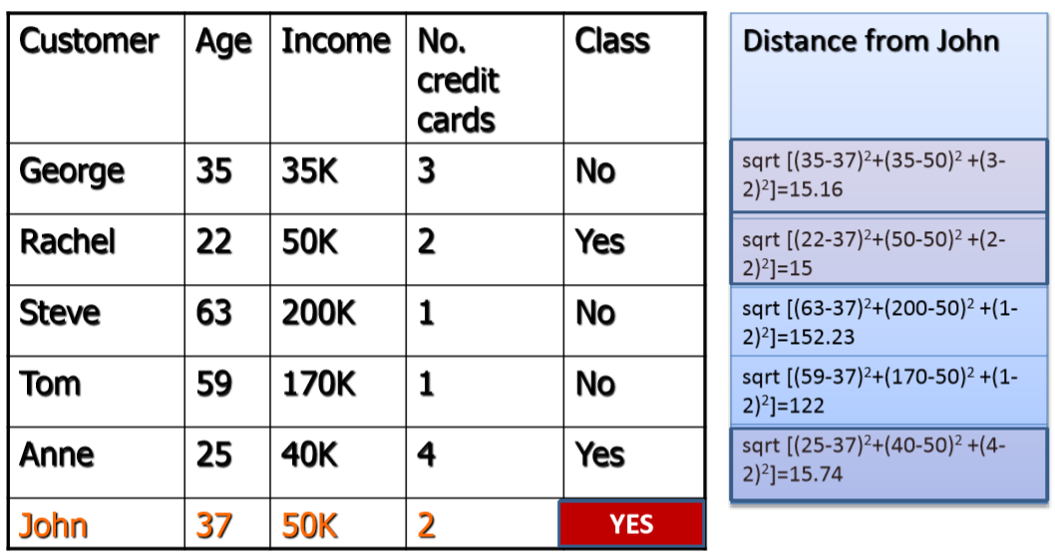
Example : 3-KNN

Slide 9
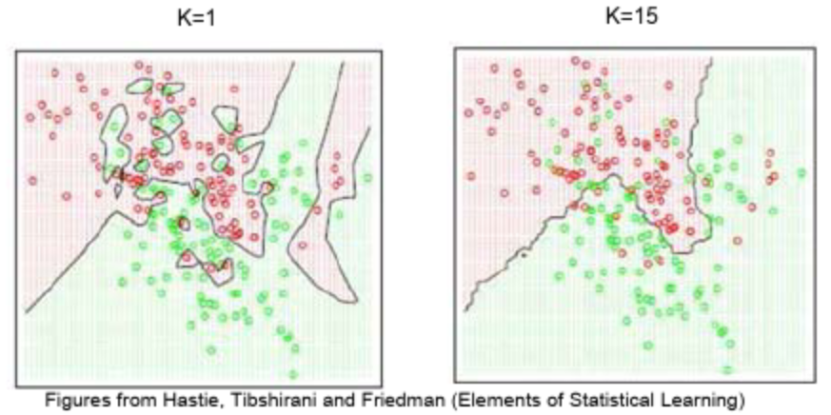
How to choose K?
Effect of K
If K is too small, it is sensitive to noise points.
Too large K may include majority points in other classes.
Almost the same as in K-means algorithm.
Rule of thumb, Elbow Method

Slide 10
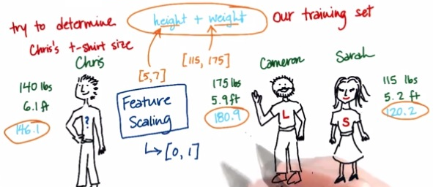
Feature scaling
Distance between neighbors could be dominated by some attributes with relatively large numbers.
Problems rise when two features are in different scales.
Important to scale those features.
Standard scaling, MinMax scaling, Maxabs scaling, etc

Slide 11

KNN variations
Weighted K-NN
takes the weights associated with each attribute. This can give priority among attributes.
How to know the weights?
Prior knowledge
We already know which attributes are more important
Cross-validation.
i.e. Measure the importance through computing the accuracy by subtracting the classes alternately.

Slide 12
Pros vs. Cons
Pros
Extremely simple and intuitive.
Only two parameters (K, distance function) required.
Need no training prior to making real time predictions.
Can be applied to any distributed data.
Good classification if # of samples is large enough.
Cons
Dependent on K value.
Computationally expensive at test stage.
has a high prediction cost for large datasets.
Need large number of samples for accuracy.
Difficult to work well with categorical features.

Slide 13
Applications of KNN Classifier
Used in classification
Used to get missing values
Used in pattern recognition
Used in gene expression
Used in protein-protein prediction
Used to get 3D structure of protein
Used to measure document similarity

Slide 14
Conclusion
Simple, easy to understand and explain
Very flexible decision boundaries
Not much learning at all!
It can be hard to find a good distance measure
Irrelevant features and noise can be very harmful
Typically can not handle more than a few dozen attributes : curse of dimensionality
Computational cost: requires a lot computation

Slide 15

Q & A

